Slide 1
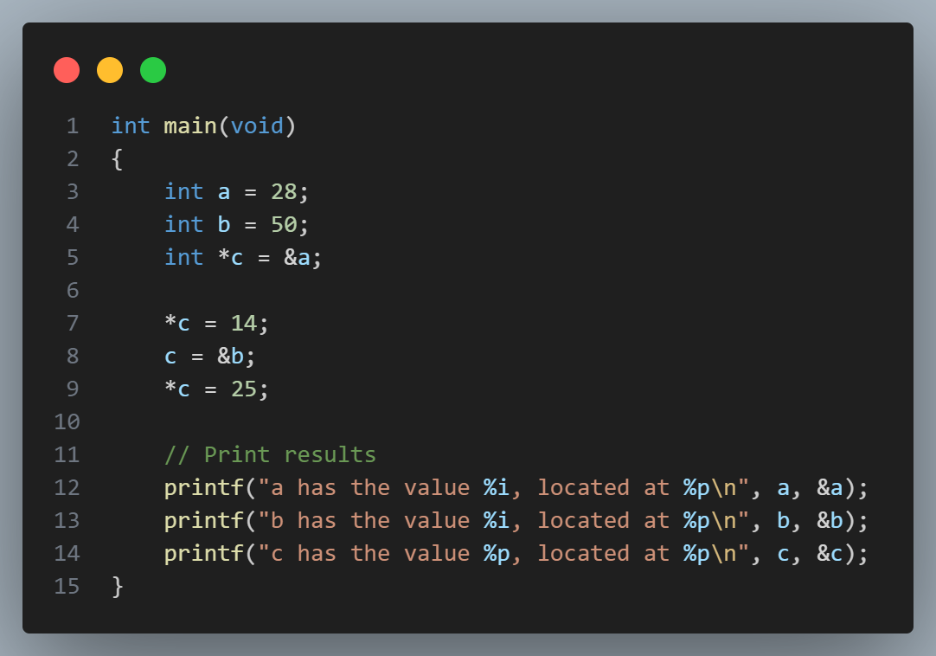
If you can, try to think about what each of these values are at different lines. When you’ve thought about it, try it! (code in Slack)

Slide 2

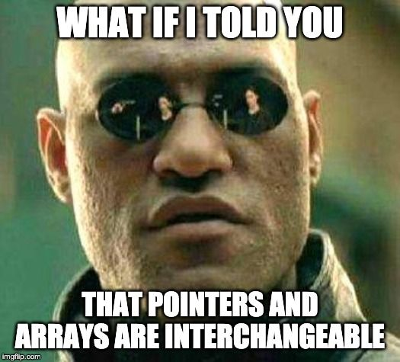

Slide 3
cs50 section 4
Memory
Andrew Holmes 2023

Slide 4
Today’s plan
Pointers
03
Dynamic memory
01
02
Files
04
PSET
Pointing fingers is rude
Using ‘the heap’
Bigger I/O
Looking ahead!

Slide 5
01
Pointers
Working with addresses & pointers

Slide 6
Pointers
Pointers
num
int num = 4;
4
0x1A

Slide 7
Pointers
Pointers
num
int num = 4;
num = 5;
5
4
0x1A

Slide 8
Pointers
Pointers
int num = 4;
num = 5;
int* addr = &num;
num
addr
5
0x1A
0x1A
0x2B
get the address of

Slide 9
Pointers
Pointers
int num = 4;
num = 5;
int* addr = &num;
get the address of
num
addr
5
0x1A
0x1A
0x2B
addr doesn’t store an int, it stores the address of an int
This is known as a pointer!

Slide 10
Pointers
Pointers
int num = 4;
num = 5;
int* addr = &num;
*addr = 6;
get the address of
num
addr
6
5
0x1A
0x1A
0x2B
We use * to ‘dereference’ a pointer – to go to that location!

Slide 11
Pointer recap
Pointers
num stores the variable
num
addr
6
&num gets the address of the variable
5
0x1A
0x1A
0x2B
*addr goes to an address

Slide 12
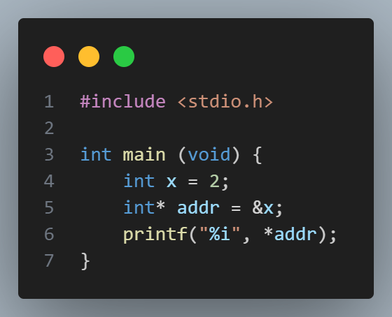
Star balance trick
Pointers
addr type: (int *)
*addr type: *(int *)
* on either side cancel!
*addr type: int

Slide 13
Exercise
Now try this again and discuss with a partner what you think will be printed by this program

Slide 14
02
Files
Larger I/O!

Slide 15
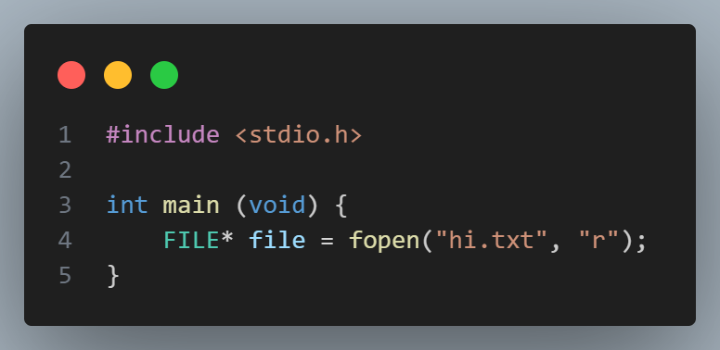

Looking at files!
Files
hi.txt
file
0x546
0x546

Slide 16
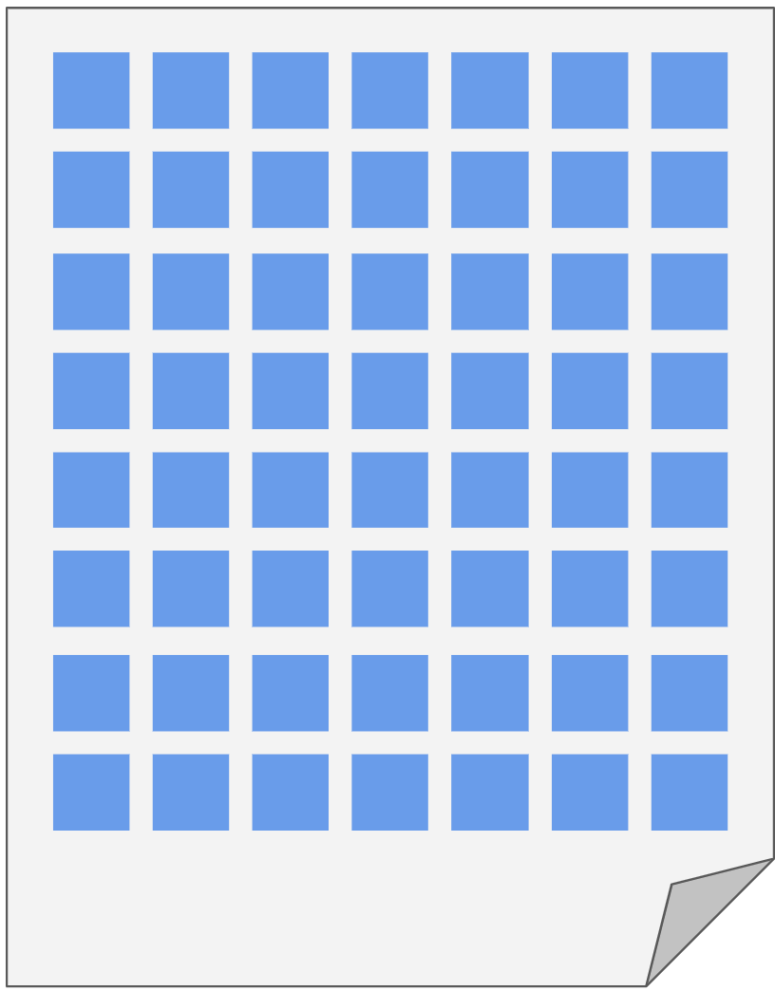
Thinking about files
Files
hi.txt
hi.txt
0x546
0x546

Slide 17
Reading from files
Files
Location to store what we found
The size (in bytes) of chunks we want to read
The number of chunks to read
The file we want to read from!
Desired read size: size * nmemb

Slide 18
Reading from files
Files
must return <= nmemb
Returns the number of chunks that were read successfully
(not the number of bytes, unless size = 1)

Slide 19
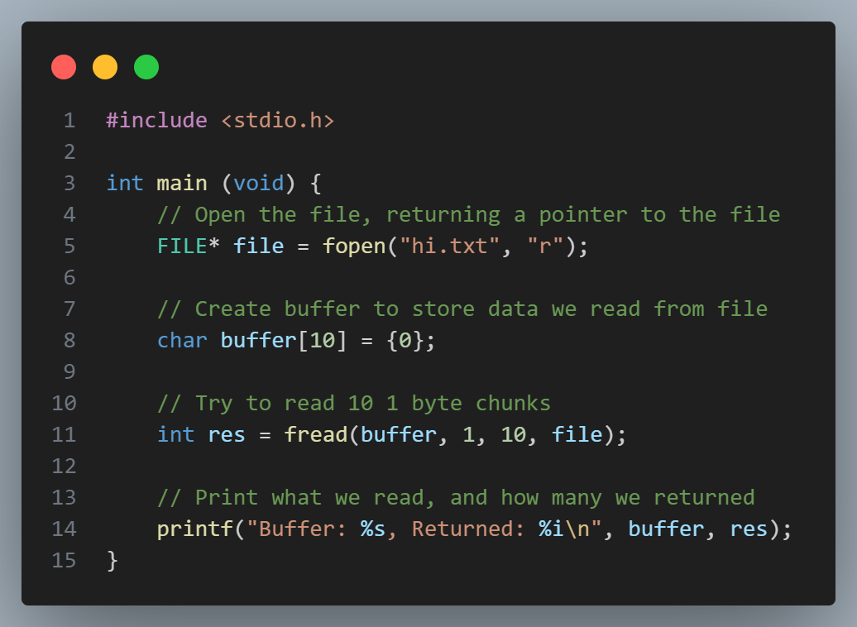
Reading from a file example
Files
hi.txt
0x546
Notes:
Code in open_read.c

Slide 20
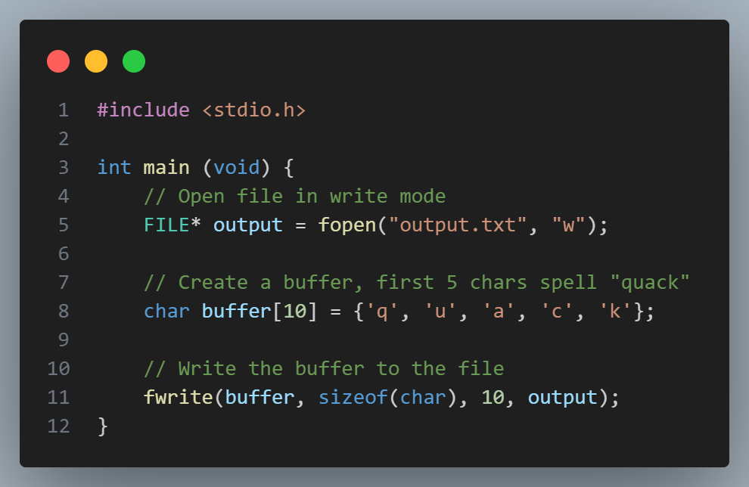
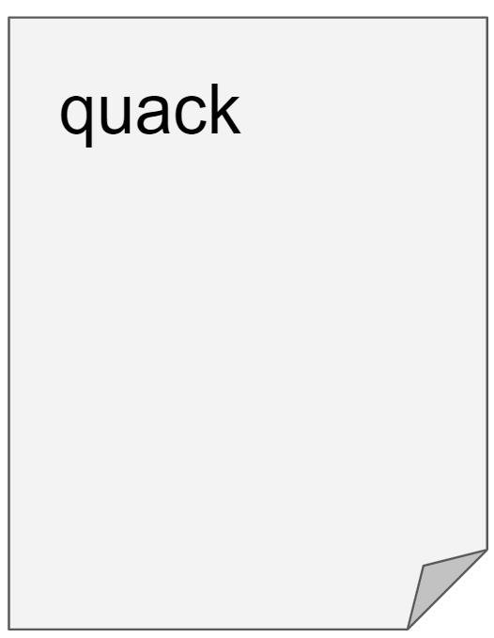
Writing from a file example
Files
output.txt
0xF29
Notes:
Code in open_read.c

Slide 21
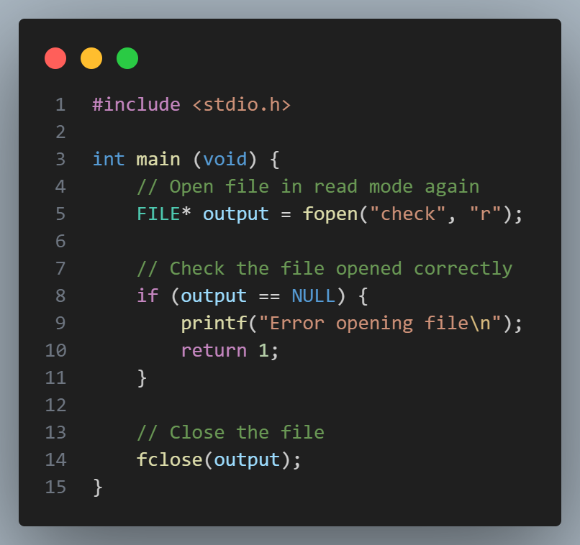
Checking file opens
Files
We are running ./check but the program tries to access that file while it is being run. This won’t be allowed (otherwise people could modify your programs as you were running them), so this won’t work!
check.c
We must always check we correctly open a file before using it!
We should also close files once we are done with them!
Notes:
Code in open_read.c

Slide 22

Files
PSET 4: Volume
Implement volume in pairs!
Practice

Slide 23
03
Dynamic memory
Malloc & Free

Slide 24
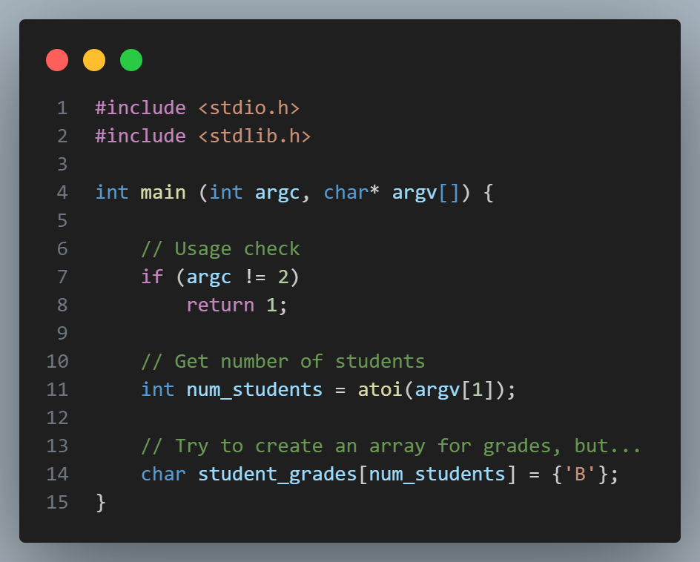
Do we need malloc?
Memory
Does this code work? What might be an issue with it?

Slide 25
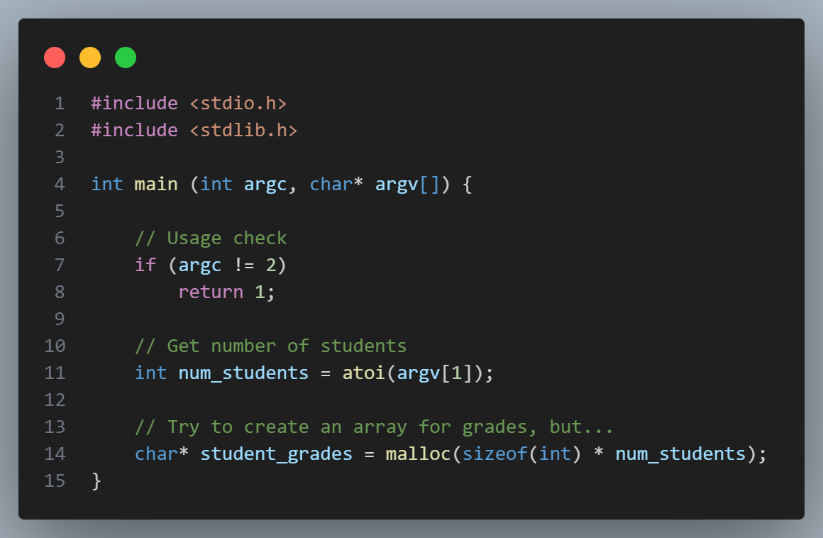












malloc
Memory
malloc
memory allocate
Dynamically assigns memory for us!

Slide 26
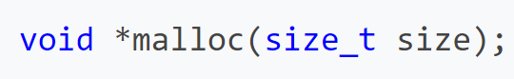
malloc
Memory
Gives an address where you can store that number of bytes
Request some number of bytes

Slide 27
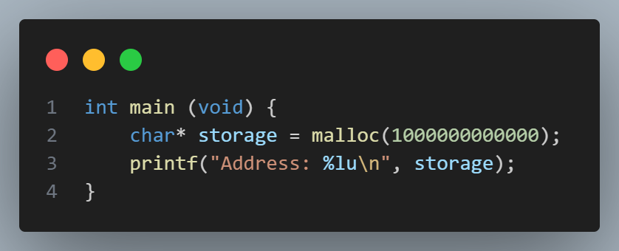
Treading carefully
Memory
Remember: malloc can fail. If it fails, it will return a null pointer (i.e. 0). You should always check for this before attempting to use memory returned by malloc.

Slide 28
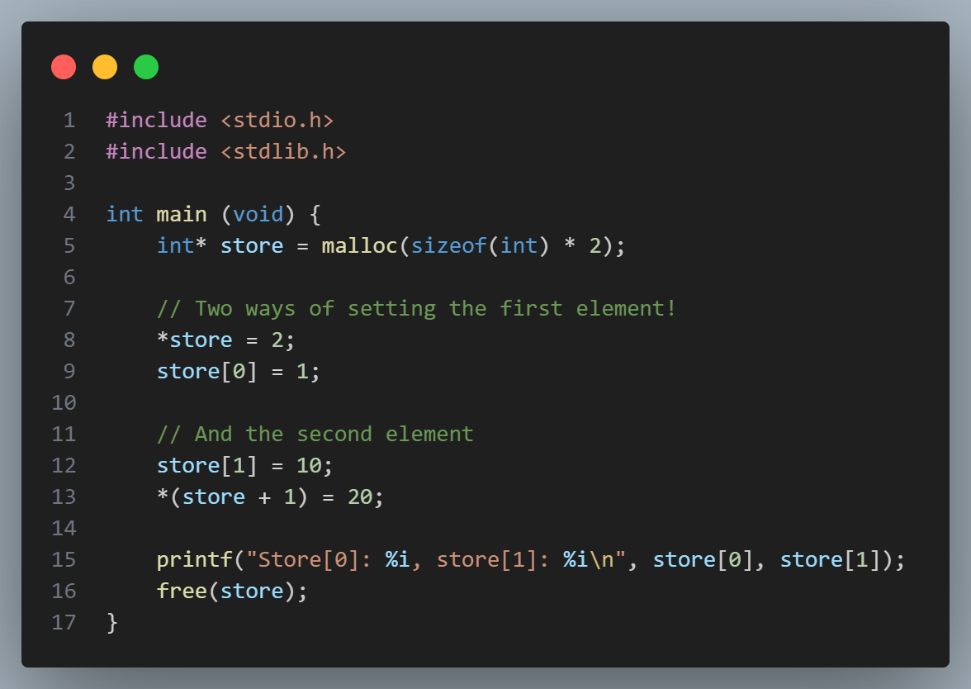
Memory
We can treat the memory returned as an array (malloc returns contiguous memory)
Or as a pointer and use pointer arithmetic.

Slide 29
Cleaning up after yourself
Memory
Notice: I called free(store)
Do we need to do this? What does it do?

Slide 30
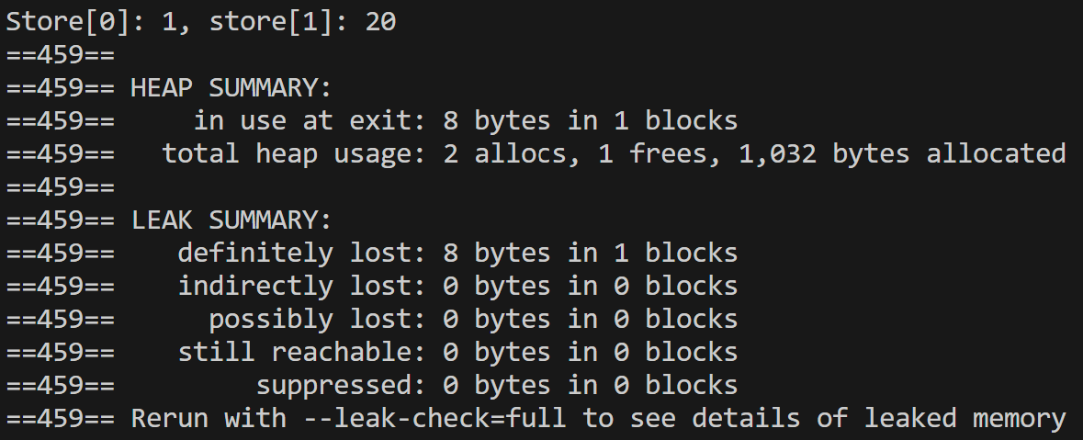
Cleaning up after yourself
Memory
Let’s run: valgrind ./star
Uh oh! We are losing memory!!

Slide 31
Cleaning up after yourself
Memory
Let’s put back that free statement…

Slide 32
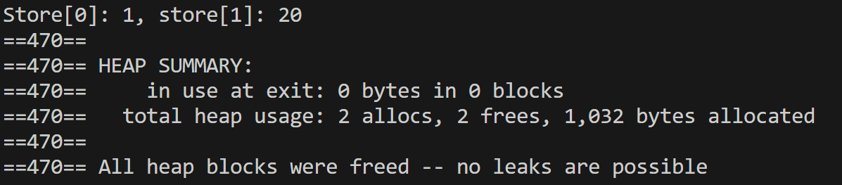
Cleaning up after yourself
Memory
Let’s run: valgrind ./star
That’s much better!

Slide 33
Memory
Implement concatenate
Concatenate two strings together and print the resulting string! See Slack for details!
Practice

Slide 34
04
PSET
Week ahead

Slide 35
PSET notes
PSET
There’s a lot of other file-related functions we haven’t used today. For example, the following may be useful:
sprintf
fgetc
fputc
Look up <stdio.h> or the functions themselves for details!

Slide 36
PSET info
PSET
In filter, I would think about:
When moving structs, move the whole struct in one go
When might it be dangerous to alter the original image (e.g. might calculating a pixel affect the following pixels? How could you solve this?)

Slide 37
PSET info
PSET
In recover, I would think about:
The walkthrough video on this one is particularly helpful.
How to make sure you have read everything? How to make sure you are closing and opening files correctly?

